Slide 1
Computer Networks: A Systems Approach, 5e
Larry L. Peterson and Bruce S. Davie
Chapter 2
Getting Connected
Copyright © 2010, Elsevier Inc. All rights Reserved
Notes:
The University of Adelaide, School of Computer Science
Chapter 2 — Instructions: Language of the Computer

Slide 2
Problems
In Chapter 1 we saw networks consists of links interconnecting nodes. How to connect two nodes together?
We also introduced the concept of “cloud” abstractions to represent a network without revealing its internal complexities. How to connect a host to a cloud?
Notes:
The University of Adelaide, School of Computer Science
Chapter 2 — Instructions: Language of the Computer

Slide 3
Chapter Outline
Perspectives on Connecting nodes
Encoding
Framing
Error Detection
Reliable Transmission
Ethernet and Multiple Access Networks
Wireless Networks
Notes:
The University of Adelaide, School of Computer Science
Chapter 2 — Instructions: Language of the Computer

Slide 4
Chapter Goal
Exploring different communication medium over which we can send data
Understanding the issue of encoding bits onto transmission medium so that they can be understood by the receiving end
Discussing the matter of delineating the sequence of bits transmitted over the link into complete messages that can be delivered to the end node
Discussing different technique to detect transmission errors and take the appropriate action
Notes:
The University of Adelaide, School of Computer Science
Chapter 2 — Instructions: Language of the Computer

Slide 5
Chapter Goal (contd.)
Discussing the issue of making the links reliable in spite of transmission problems
Introducing Media Access Control Problem
Introducing Carrier Sense Multiple Access (CSMA) networks
Introducing Wireless Networks with different available technologies and protocol
Notes:
The University of Adelaide, School of Computer Science
Chapter 2 — Instructions: Language of the Computer

Slide 6
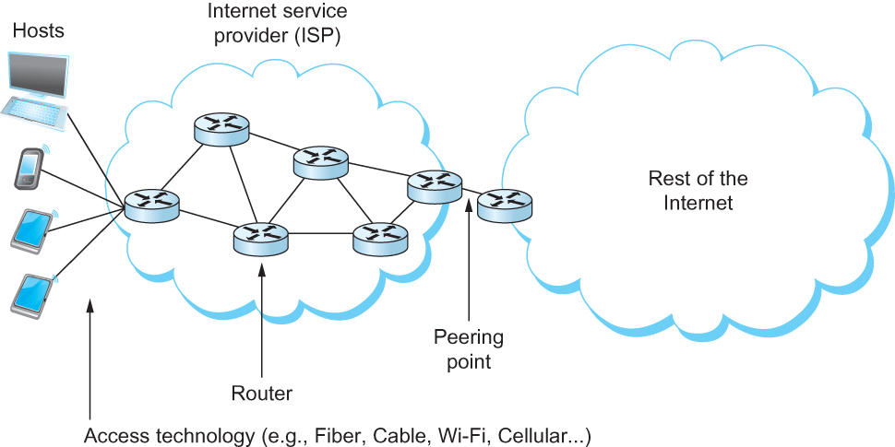
Perspectives on Connecting
An end-user’s view of the Internet

Slide 7
Link Capacity and Shannon-Hartley Theorem
Gives the upper bound to the capacity of a link in terms of bits per second (bps) as a function of signal-to-noise ratio of the link measured in decibels (dB).
C = Blog₂(1+S/N)
  Where B = 3300 – 300 = 3000Hz, S is the signal power, N the average noise.
  The signal to noise ratio (S/N) is measured in decibels is related to dB = 10 x log₁₀(S/N). If there is 30dB of noise then S/N = 1000.
  Now C = 3000 x log₂(1001) = 30kbps.
  How can we get 56kbps?
Notes:
The University of Adelaide, School of Computer Science
Chapter 2 — Instructions: Language of the Computer

Slide 8
Links
All practical links rely on some sort of electromagnetic radiation propagating through a medium or, in some cases, through free space
One way to characterize links, then, is by the medium they use
  Typically copper wire in some form (as in Digital Subscriber Line (DSL) and coaxial cable),
  Optical fiber (as in both commercial fiber-to-the home services and many long-distance links in the Internet’s backbone), or
  Air/free space (for wireless links)
Notes:
The University of Adelaide, School of Computer Science
Chapter 2 — Instructions: Language of the Computer

Slide 9
Links
Another important link characteristic is the frequency
  Measured in hertz, with which the electromagnetic waves oscillate
Distance between the adjacent pair of maxima or minima of a wave measured in meters is called wavelength
  Speed of light divided by frequency gives the wavelength.
  Frequency on a copper cable range from 300Hz to 3300Hz; Wavelength for 300Hz wave through copper is speed of light on a copper / frequency
  2/3 x 3 x 10⁸ /300 = 667 x 10³ meters.
Placing binary data on a signal is called encoding.
Modulation involves modifying the signals in terms of their frequency, amplitude, and phase.
Notes:
The University of Adelaide, School of Computer Science
Chapter 2 — Instructions: Language of the Computer

Slide 10
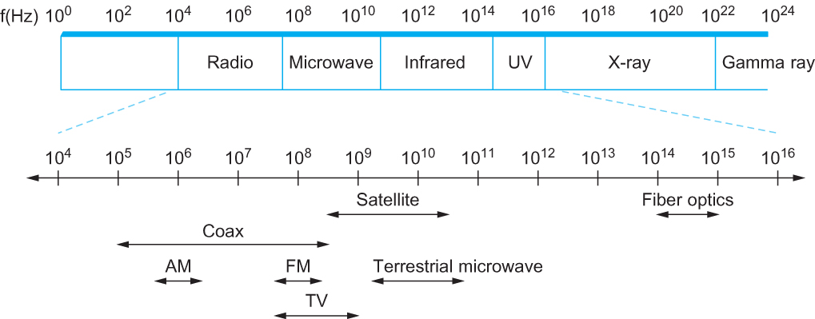
Links
Electromagnetic spectrum

Slide 11
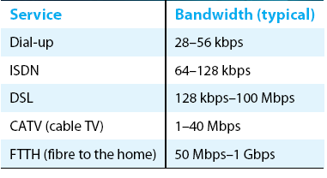
Links
Common services available to connect your home

Slide 12
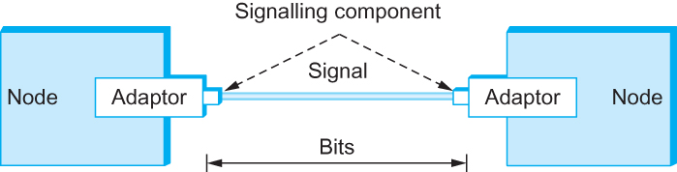
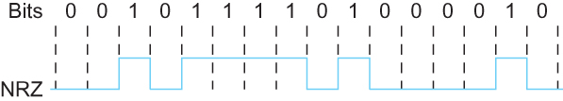
Encoding
Signals travel between signaling components; bits flow between adaptors
NRZ encoding of a bit stream

Slide 13
Encoding
Problem with NRZ
  Baseline wander
    The receiver keeps an average of the signals it has seen so far
    Uses the average to distinguish between low and high signal
    When a signal is significantly low than the average, it is 0, else it is 1
    Too many consecutive 0’s and 1’s cause this average to change, making it difficult to detect
Notes:
The University of Adelaide, School of Computer Science
Chapter 2 — Instructions: Language of the Computer

Slide 14
Encoding
Problem with NRZ
  Clock recovery
    Frequent transition from high to low or vice versa are necessary to enable clock recovery
    Both the sending and decoding process is driven by a clock
    Every clock cycle, the sender transmits a bit and the receiver recovers a bit
    The sender and receiver have to be precisely synchronized
Notes:
The University of Adelaide, School of Computer Science
Chapter 2 — Instructions: Language of the Computer

Slide 15
Encoding
NRZI
  Non Return to Zero Inverted
  Sender makes a transition from the current signal to encode 1 and stay at the current signal to encode 0
  Solves for consecutive 1’s
Notes:
The University of Adelaide, School of Computer Science
Chapter 2 — Instructions: Language of the Computer

Slide 16
Encoding
Manchester encoding
  Merging the clock with signal by transmitting Ex-OR of the NRZ encoded data and the clock
  Clock is an internal signal that alternates from low to high, a low/high pair is considered as one clock cycle
  In Manchester encoding
    0: low→ high transition
    1: high→ low transition
Notes:
The University of Adelaide, School of Computer Science
Chapter 2 — Instructions: Language of the Computer

Slide 17
Encoding
Problem with Manchester encoding
  Doubles the rate at which the signal transitions are made on the link
    Which means the receiver has half of the time to detect each pulse of the signal
  The rate at which the signal changes is called the link’s baud rate
  In Manchester the bit rate is half the baud rate
Notes:
The University of Adelaide, School of Computer Science
Chapter 2 — Instructions: Language of the Computer

Slide 18
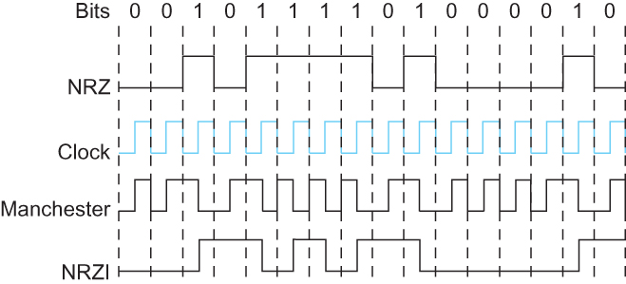
Encoding
Different encoding strategies

Slide 19
Encoding
4B/5B encoding
  Insert extra bits into bit stream so as to break up the long sequence of 0’s and 1’s
  Every 4-bits of actual data are encoded in a 5- bit code that is transmitted to the receiver
  5-bit codes are selected in such a way that each one has no more than one leading 0(zero) and no more than two trailing 0’s.
  No pair of 5-bit codes results in more than three consecutive 0’s
Notes:
The University of Adelaide, School of Computer Science
Chapter 2 — Instructions: Language of the Computer

Slide 20
Encoding
4B/5B encoding
0000 → 11110 16 left
0001 → 01001 11111 – when the line is idle
0010 → 10100 00000 – when the line is dead
.. 00100 – to mean halt
..
1111 → 11101 13 left : 7 invalid, 6 for various control signals
Notes:
The University of Adelaide, School of Computer Science
Chapter 2 — Instructions: Language of the Computer

Slide 21
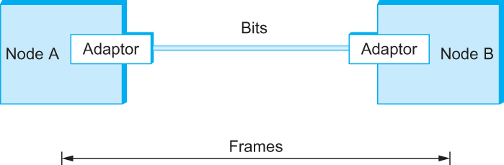
Framing
We are focusing on packet-switched networks, which means that blocks of data (called frames at this level), not bit streams, are exchanged between nodes.
It is the network adaptor that enables the nodes to exchange frames.
Bits flow between adaptors, frames between hosts
Notes:
The University of Adelaide, School of Computer Science
Chapter 2 — Instructions: Language of the Computer

Slide 22
Framing
When node A wishes to transmit a frame to node B, it tells its adaptor to transmit a frame from the node’s memory. This results in a sequence of bits being sent over the link.
The adaptor on node B then collects together the sequence of bits arriving on the link and deposits the corresponding frame in B’s memory.
Recognizing exactly what set of bits constitute a frame—that is, determining where the frame begins and ends—is the central challenge faced by the adaptor
Notes:
The University of Adelaide, School of Computer Science
Chapter 2 — Instructions: Language of the Computer

Slide 23
Framing
Byte-oriented Protocols
  To view each frame as a collection of bytes (characters) rather than bits
  BISYNC (Binary Synchronous Communication) Protocol
    Developed by IBM (late 1960)
  DDCMP (Digital Data Communication Protocol)
    Used in DECNet
Notes:
The University of Adelaide, School of Computer Science
Chapter 2 — Instructions: Language of the Computer

Slide 24
Framing
BISYNC – sentinel approach
  Frames transmitted beginning with leftmost field
  Beginning of a frame is denoted by sending a special SYN (synchronize) character
  Data portion of the frame is contained between special sentinel character STX (start of text) and ETX (end of text)
  SOH : Start of Header
  DLE : Data Link Escape
  CRC: Cyclic Redundancy Check
Notes:
The University of Adelaide, School of Computer Science
Chapter 2 — Instructions: Language of the Computer

Slide 25

Framing
BISYNC Frame Format

Slide 26
Framing
Recent PPP which is commonly run over Internet links uses sentinel approach
  Special start of text character denoted as Flag
    0 1 1 1 1 1 1 0
  Address, control : default numbers
  Protocol for demux : IP / IPX
  Payload : negotiated (1500 bytes)
  Checksum : for error detection
Notes:
The University of Adelaide, School of Computer Science
Chapter 2 — Instructions: Language of the Computer

Slide 27

Framing
PPP Frame Format

Slide 28
Framing
Byte-counting approach
  DDCMP
  count : how many bytes are contained in the frame body
  If count is corrupted
    Framing error
Notes:
The University of Adelaide, School of Computer Science
Chapter 2 — Instructions: Language of the Computer

Slide 29

Framing
DDCMP Frame Format

Slide 30

Framing
Bit-oriented Protocol
  HDLC : High Level Data Link Control
    Beginning and Ending Sequences
      0 1 1 1 1 1 1 0
HDLC Frame Format
Notes:
The University of Adelaide, School of Computer Science
Chapter 2 — Instructions: Language of the Computer

Slide 31
Framing
HDLC Protocol
  On the sending side, any time five consecutive 1’s have been transmitted from the body of the message (i.e. excluding when the sender is trying to send the distinguished 01111110 sequence)
    The sender inserts 0 before transmitting the next bit
Notes:
The University of Adelaide, School of Computer Science
Chapter 2 — Instructions: Language of the Computer

Slide 32
Framing
HDLC Protocol
  On the receiving side
    5 consecutive 1’s
      Next bit 0 : Stuffed, so discard it
      1 : Either End of the frame marker
      Or Error has been introduced in the bitstream
      Look at the next bit
      If 0 ( 01111110 ) → End of the frame marker
      If 1 ( 01111111 ) → Error, discard the whole frame
      The receiver needs to wait for next
      01111110 before it can start
      receiving again
Notes:
The University of Adelaide, School of Computer Science
Chapter 2 — Instructions: Language of the Computer

Slide 33
Error Detection
Bit errors are introduced into frames
  Because of electrical interference and thermal noises
Detecting Error
Correction Error
Two approaches when the recipient detects an error
  Notify the sender that the message was corrupted, so the sender can send again.
    If the error is rare, then the retransmitted message will be error-free
  Using some error correct detection and correction algorithm, the receiver reconstructs the message
Notes:
The University of Adelaide, School of Computer Science
Chapter 2 — Instructions: Language of the Computer

Slide 34
Error Detection
Common technique for detecting transmission error
  CRC (Cyclic Redundancy Check)
    Used in HDLC, DDCMP, CSMA/CD, Token Ring
  Other approaches
    Two Dimensional Parity (BISYNC)
    Checksum (IP)
Notes:
The University of Adelaide, School of Computer Science
Chapter 2 — Instructions: Language of the Computer

Slide 35
Error Detection
Basic Idea of Error Detection
  To add redundant information to a frame that can be used to determine if errors have been introduced
  Imagine (Extreme Case)
    Transmitting two complete copies of data
      Identical → No error
      Differ → Error
      Poor Scheme ???
        n bit message, n bit redundant information
        Error can go undetected
    In general, we can provide strong error detection technique
      k redundant bits, n bits message, k << n
      In Ethernet, a frame carrying up to 12,000 bits of data requires only 32-bit CRC
Notes:
The University of Adelaide, School of Computer Science
Chapter 2 — Instructions: Language of the Computer

Slide 36
Error Detection
Extra bits are redundant
  They add no new information to the message
  Derived from the original message using some algorithm
  Both the sender and receiver know the algorithm
  Sender Receiver
Receiver computes r using m
If they match, no error
m
r
m
r
Notes:
The University of Adelaide, School of Computer Science
Chapter 2 — Instructions: Language of the Computer

Slide 37
Two-dimensional parity
Two-dimensional parity is exactly what the name suggests
It is based on “simple” (one-dimensional) parity, which usually involves adding one extra bit to a 7-bit code to balance the number of 1s in the byte. For example,
  Odd parity sets the eighth bit to 1 if needed to give an odd number of 1s in the byte, and
  Even parity sets the eighth bit to 1 if needed to give an even number of 1s in the byte
Notes:
The University of Adelaide, School of Computer Science
Chapter 2 — Instructions: Language of the Computer

Slide 38
Two-dimensional parity
Two-dimensional parity does a similar calculation for each bit position across each of the bytes contained in the frame
This results in an extra parity byte for the entire frame, in addition to a parity bit for each byte
Two-dimensional parity catches all 1-, 2-, and 3-bit errors and most 4-bit errors
Notes:
The University of Adelaide, School of Computer Science
Chapter 2 — Instructions: Language of the Computer

Slide 39
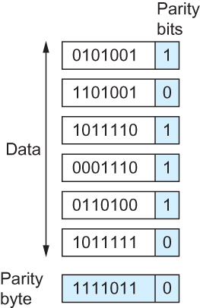
Two-dimensional parity
Two Dimensional Parity

Slide 40
Internet Checksum Algorithm
Not used at the link level
Add up all the words that are transmitted and then transmit the result of that sum
  The result is called the checksum
The receiver performs the same calculation on the received data and compares the result with the received checksum
If any transmitted data, including the checksum itself, is corrupted, then the results will not match, so the receiver knows that an error occurred
Notes:
The University of Adelaide, School of Computer Science
Chapter 2 — Instructions: Language of the Computer

Slide 41
Internet Checksum Algorithm
Consider the data being checksummed as a sequence of 16-bit integers.
Add them together using 16-bit ones complement arithmetic (explained next slide) and then take the ones complement of the result.
That 16-bit number is the checksum
Notes:
The University of Adelaide, School of Computer Science
Chapter 2 — Instructions: Language of the Computer

Slide 42
Internet Checksum Algorithm
In ones complement arithmetic, a negative integer −x is represented as the complement of x;
  Each bit of x is inverted.
When adding numbers in ones complement arithmetic, a carryout from the most significant bit needs to be added to the result.
Notes:
The University of Adelaide, School of Computer Science
Chapter 2 — Instructions: Language of the Computer

Slide 43
Internet Checksum Algorithm
Consider, for example, the addition of −5 and −3 in ones complement arithmetic on 4-bit integers
  +5 is 0101, so −5 is 1010; +3 is 0011, so −3 is 1100
If we add 1010 and 1100 ignoring the carry, we get 0110
In ones complement arithmetic, the fact that this operation caused a carry from the most significant bit causes us to increment the result, giving 0111, which is the ones complement representation of −8 (obtained by inverting the bits in 1000), as we would expect
Notes:
The University of Adelaide, School of Computer Science
Chapter 2 — Instructions: Language of the Computer

Slide 44
Cyclic Redundancy Check (CRC)
Reduce the number of extra bits and maximize protection
Given a bit string 110001 we can associate a polynomial on a single variable x for it.
  1.x⁵+1.x⁴+0.x³+0.x²+0.x¹+1.x⁰ = x⁵+x⁴+1 and the degree is 5.
  A k-bit frame has a maximum degree of k-1
Let M(x) be a message polynomial and C(x) be a generator polynomial.
Notes:
The University of Adelaide, School of Computer Science
Chapter 2 — Instructions: Language of the Computer

Slide 45
Cyclic Redundancy Check (CRC)
Let M(x)/C(x) leave a remainder of 0.
When M(x) is sent and M’(x) is received we have M’(x) = M(x)+E(x)
The receiver computes M’(x)/C(x) and if the remainder is nonzero, then an error has occurred.
The only thing the sender and the receiver should know is C(x).
Notes:
The University of Adelaide, School of Computer Science
Chapter 2 — Instructions: Language of the Computer

Slide 46
Cyclic Redundancy Check (CRC)
Polynomial Arithmetic Modulo 2
  Any polynomial B(x) can be divided by a divisor polynomial C(x) if B(x) is of higher degree than C(x).
  Any polynomial B(x) can be divided once by a divisor polynomial C(x) if B(x) is of the same degree as C(x).
  The remainder obtained when B(x) is divided by C(x) is obtained by subtracting C(x) from B(x).
  To subtract C(x) from B(x), we simply perform the exclusive-OR (XOR) operation on each pair of matching coefficients.
Notes:
The University of Adelaide, School of Computer Science
Chapter 2 — Instructions: Language of the Computer

Slide 47
Cyclic Redundancy Check (CRC)
Let M(x) be a frame with m bits and let the generator polynomial have less than m bits say equal to r.
Let r be the degree of C(x). Append r zero bits to the low-order end of the frame, so it now contains m+r bits and corresponds to the polynomial x^{r}M(x).
Notes:
The University of Adelaide, School of Computer Science
Chapter 2 — Instructions: Language of the Computer

Slide 48
Cyclic Redundancy Check (CRC)
Divide the bit string corresponding to x^{r}M(x) by the bit string corresponding to C(x) using modulo 2 division.
Subtract the remainder (which is always r or fewer bits) from the string corresponding to x^{r}M(x) using modulo 2 subtraction (addition and subtraction are the same in modulo 2).
The result is the checksummed frame to be transmitted. Call it polynomial M’(x).
Notes:
The University of Adelaide, School of Computer Science
Chapter 2 — Instructions: Language of the Computer

Slide 49
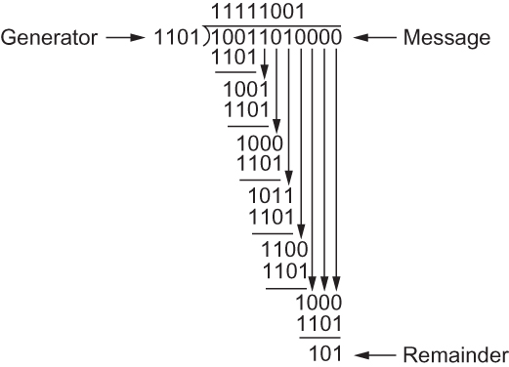
Cyclic Redundancy Check (CRC)
CRC Calculation using Polynomial Long Division

Slide 50
Cyclic Redundancy Check (CRC)
Properties of Generator Polynomial
  Let P(x) represent what the sender sent and P(x) + E(x) is the received string. A 1 in E(x) represents that in the corresponding position in P(x) the message the bit is flipped.
  We know that P(x)/C(x) leaves a remainder of 0, but if E(x)/C(x) leaves a remainder of 0, then either E(x) = 0 or C(x) is factor of E(x).
  When C(x) is a factor of E(x) we have problem; errors go unnoticed.
  If there is a single bit error then E(x) = x^{i}, where i determines the bit in error. If C(x) contains two or more terms it will never divide E(x), so all single bit errors will be detected.
Notes:
The University of Adelaide, School of Computer Science
Chapter 2 — Instructions: Language of the Computer

Slide 51
Cyclic Redundancy Check (CRC)
Properties of Generator Polynomial
  In general, it is possible to prove that the following types of errors can be detected by a C(x) with the stated properties
    All single-bit errors, as long as the x^{k} and x⁰ terms have nonzero coefficients.
    All double-bit errors, as long as C(x) has a factor with at least three terms.
    Any odd number of errors, as long as C(x) contains the factor (x+1).
    Any “burst” error (i.e., sequence of consecutive error bits) for which the length of the burst is less than k bits. (Most burst errors of larger than k bits can also be detected.)
Notes:
The University of Adelaide, School of Computer Science
Chapter 2 — Instructions: Language of the Computer

Slide 52
Cyclic Redundancy Check (CRC)
Six generator polynomials that have become international standards are:
  CRC-8 = x⁸+x²+x+1
  CRC-10 = x¹⁰+x⁹+x⁵+x⁴+x+1
  CRC-12 = x¹²+x¹¹+x³+x²+x+1
  CRC-16 = x¹⁶+x¹⁵+x²+1
  CRC-CCITT = x¹⁶+x¹²+x⁵+1
  CRC-32 = x³²+x²⁶+x²³+x²²+x¹⁶+x¹²+x¹¹+x¹⁰+x⁸+x⁷+x⁵+x⁴+x²+x+1
Notes:
The University of Adelaide, School of Computer Science
Chapter 2 — Instructions: Language of the Computer

Slide 53
Reliable Transmission
CRC is used to detect errors.
Some error codes are strong enough to correct errors.
The overhead is typically too high.
Corrupt frames must be discarded.
A link-level protocol that wants to deliver frames reliably must recover from these discarded frames.
This is accomplished using a combination of two fundamental mechanisms
  Acknowledgements and Timeouts
Notes:
The University of Adelaide, School of Computer Science
Chapter 2 — Instructions: Language of the Computer

Slide 54
Reliable Transmission
An acknowledgement (ACK for short) is a small control frame that a protocol sends back to its peer saying that it has received the earlier frame.
  A control frame is a frame with header only (no data).
The receipt of an acknowledgement indicates to the sender of the original frame that its frame was successfully delivered.
Notes:
The University of Adelaide, School of Computer Science
Chapter 2 — Instructions: Language of the Computer

Slide 55
Reliable Transmission
If the sender does not receive an acknowledgment after a reasonable amount of time, then it retransmits the original frame.
The action of waiting a reasonable amount of time is called a timeout.
The general strategy of using acknowledgements and timeouts to implement reliable delivery is sometimes called Automatic Repeat reQuest (ARQ).
Notes:
The University of Adelaide, School of Computer Science
Chapter 2 — Instructions: Language of the Computer

Slide 56
Stop and Wait Protocol
Idea of stop-and-wait protocol is straightforward
  After transmitting one frame, the sender waits for an acknowledgement before transmitting the next frame.
  If the acknowledgement does not arrive after a certain period of time, the sender times out and retransmits the original frame
Notes:
The University of Adelaide, School of Computer Science
Chapter 2 — Instructions: Language of the Computer

Slide 57
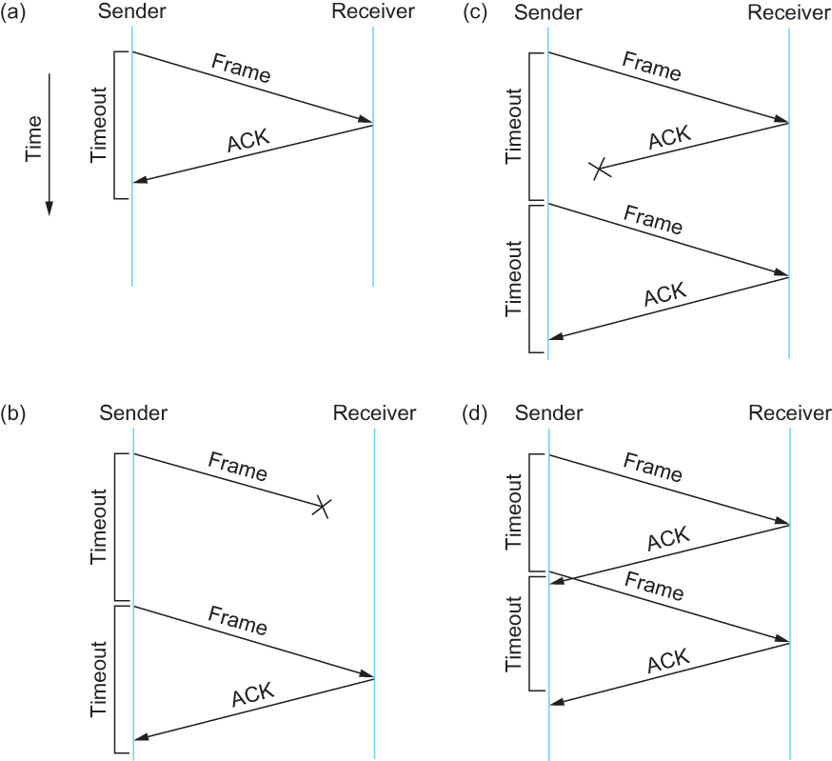
Stop and Wait Protocol
Timeline showing four different scenarios for the stop-and-wait algorithm.
(a) The ACK is received before the timer expires; (b) the original frame is lost; (c) the
ACK is lost; (d) the timeout fires too soon

Slide 58
Stop and Wait Protocol
If the acknowledgment is lost or delayed in arriving
  The sender times out and retransmits the original frame, but the receiver will think that it is the next frame since it has correctly received and acknowledged the first frame
  As a result, duplicate copies of frames will be delivered
How to solve this
  Use 1 bit sequence number (0 or 1)
  When the sender retransmits frame 0, the receiver can determine that it is seeing a second copy of frame 0 rather than the first copy of frame 1 and therefore can ignore it (the receiver still acknowledges it, in case the first acknowledgement was lost)
Notes:
The University of Adelaide, School of Computer Science
Chapter 2 — Instructions: Language of the Computer

Slide 59
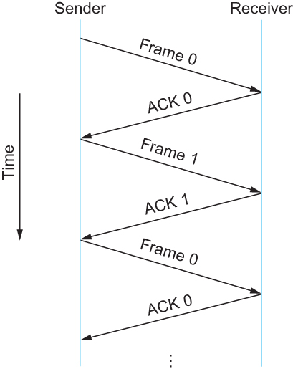
Stop and Wait Protocol
Timeline for stop-and-wait with 1-bit sequence number

Slide 60
Stop and Wait Protocol
The sender has only one outstanding frame on the link at a time
  This may be far below the link’s capacity
Consider a 1.5 Mbps link with a 45 ms RTT
  The link has a delay × bandwidth product of 67.5 Kb or approximately 8 KB
  Since the sender can send only one frame per RTT and assuming a frame size of 1 KB
  Maximum Sending rate
    Bits per frame ÷ Time per frame = 1024 × 8 ÷ 0.045 = 182 Kbps
    Or about one-eighth of the link’s capacity
  To use the link fully, then sender should transmit up to eight frames before having to wait for an acknowledgement
Notes:
The University of Adelaide, School of Computer Science
Chapter 2 — Instructions: Language of the Computer

Slide 61
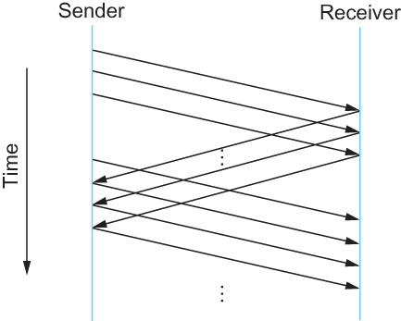
Sliding Window Protocol
Timeline for Sliding Window Protocol

Slide 62
Sliding Window Protocol
Sender assigns a sequence number denoted as SeqNum to each frame.
  Assume it can grow infinitely large
Sender maintains three variables
  Sending Window Size (SWS)
    Upper bound on the number of outstanding (unacknowledged) frames that the sender can transmit
  Last Acknowledgement Received (LAR)
    Sequence number of the last acknowledgement received
  Last Frame Sent (LFS)
    Sequence number of the last frame sent
Notes:
The University of Adelaide, School of Computer Science
Chapter 2 — Instructions: Language of the Computer

Slide 63
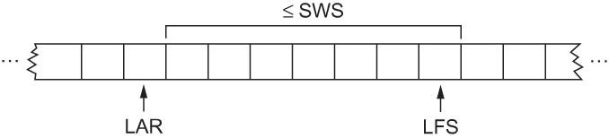
Sliding Window Protocol
Sender also maintains the following invariant
  LFS – LAR ≤ SWS
Sliding Window on Sender
Notes:
The University of Adelaide, School of Computer Science
Chapter 2 — Instructions: Language of the Computer

Slide 64
Sliding Window Protocol
When an acknowledgement arrives
  the sender moves LAR to right, thereby allowing the sender to transmit another frame
Also the sender associates a timer with each frame it transmits
  It retransmits the frame if the timer expires before the ACK is received
Note that the sender has to be willing to buffer up to SWS frames
  WHY?
Notes:
The University of Adelaide, School of Computer Science
Chapter 2 — Instructions: Language of the Computer

Slide 65
Sliding Window Protocol
Receiver maintains three variables
  Receiving Window Size (RWS)
    Upper bound on the number of out-of-order frames that the receiver is willing to accept
  Largest Acceptable Frame (LAF)
    Sequence number of the largest acceptable frame
  Last Frame Received (LFR)
    Sequence number of the last frame received
Notes:
The University of Adelaide, School of Computer Science
Chapter 2 — Instructions: Language of the Computer

Slide 66
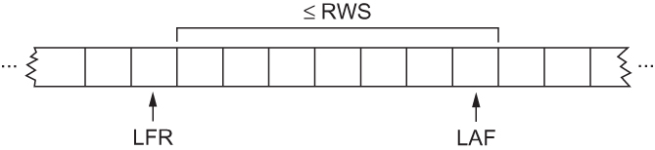
Sliding Window Protocol
Receiver also maintains the following invariant
  LAF – LFR ≤ RWS
Sliding Window on Receiver
Notes:
The University of Adelaide, School of Computer Science
Chapter 2 — Instructions: Language of the Computer

Slide 67
Sliding Window Protocol
When a frame with sequence number SeqNum arrives, what does the receiver do?
  If SeqNum ≤ LFR or SeqNum > LAF
    Discard it (the frame is outside the receiver window)
  If LFR < SeqNum ≤ LAF
    Accept it
    Now the receiver needs to decide whether or not to send an ACK
Notes:
The University of Adelaide, School of Computer Science
Chapter 2 — Instructions: Language of the Computer

Slide 68
Sliding Window Protocol
  Let SeqNumToAck
    Denote the largest sequence number not yet acknowledged, such that all frames with sequence number less than or equal to SeqNumToAck have been received
  The receiver acknowledges the receipt of SeqNumToAck even if high-numbered packets have been received
    This acknowledgement is said to be cumulative.
  The receiver then sets
    LFR = SeqNumToAck and adjusts
    LAF = LFR + RWS
Notes:
The University of Adelaide, School of Computer Science
Chapter 2 — Instructions: Language of the Computer

Slide 69
Sliding Window Protocol
For example, suppose LFR = 5 and RWS = 4
(i.e. the last ACK that the receiver sent was for seq. no. 5)
LAF = 9
If frames 7 and 8 arrive, they will be buffered because they are within the receiver window
But no ACK will be sent since frame 6 is yet to arrive
Frames 7 and 8 are out of order
Frame 6 arrives (it is late because it was lost first time and had to be retransmitted)
Now Receiver Acknowledges Frame 8
and bumps LFR to 8
and LAF to 12
Notes:
The University of Adelaide, School of Computer Science
Chapter 2 — Instructions: Language of the Computer

Slide 70
Issues with Sliding Window Protocol
When timeout occurs, the amount of data in transit decreases
  Since the sender is unable to advance its window
When the packet loss occurs, this scheme is no longer keeping the pipe full
  The longer it takes to notice that a packet loss has occurred, the more severe the problem becomes
How to improve this
  Negative Acknowledgement (NAK)
  Additional Acknowledgement
  Selective Acknowledgement
Notes:
The University of Adelaide, School of Computer Science
Chapter 2 — Instructions: Language of the Computer

Slide 71
Issues with Sliding Window Protocol
Negative Acknowledgement (NAK)
  Receiver sends NAK for frame 6 when frame 7 arrive (in the previous example)
    However this is unnecessary since sender’s timeout mechanism will be sufficient to catch the situation
Additional Acknowledgement
  Receiver sends additional ACK for frame 5 when frame 7 arrives
    Sender uses duplicate ACK as a clue for frame loss
Selective Acknowledgement
  Receiver will acknowledge exactly those frames it has received, rather than the highest number frames
    Receiver will acknowledge frames 7 and 8
    Sender knows frame 6 is lost
    Sender can keep the pipe full (additional complexity)
Notes:
The University of Adelaide, School of Computer Science
Chapter 2 — Instructions: Language of the Computer

Slide 72
Issues with Sliding Window Protocol
How to select the window size
  SWS is easy to compute
    Delay × Bandwidth
  RWS can be anything
    Two common setting
        RWS = 1
        No buffer at the receiver for frames that arrive out of order
        RWS = SWS
        The receiver can buffer frames that the sender transmits
        It does not make any sense to keep RWS > SWS
        WHY?
Notes:
The University of Adelaide, School of Computer Science
Chapter 2 — Instructions: Language of the Computer

Slide 73
Issues with Sliding Window Protocol
Finite Sequence Number
  Frame sequence number is specified in the header field
    Finite size
        3 bit: eight possible sequence number: 0, 1, 2, 3, 4, 5, 6, 7
    It is necessary to wrap around
Notes:
The University of Adelaide, School of Computer Science
Chapter 2 — Instructions: Language of the Computer

Slide 74
Issues with Sliding Window Protocol
How to distinguish between different incarnations of the same sequence number?
  Number of possible sequence number must be larger than the number of outstanding frames allowed
    Stop and Wait: One outstanding frame
        2 distinct sequence number (0 and 1)
    Let MaxSeqNum be the number of available sequence numbers
    SWS + 1 ≤ MaxSeqNum
      Is this sufficient?
Notes:
The University of Adelaide, School of Computer Science
Chapter 2 — Instructions: Language of the Computer

Slide 75
Issues with Sliding Window Protocol
SWS + 1 ≤ MaxSeqNum
      Is this sufficient?
      Depends on RWS
      If RWS = 1, then sufficient
      If RWS = SWS, then not good enough
For example, we have eight sequence numbers
0, 1, 2, 3, 4, 5, 6, 7
RWS = SWS = 7
Sender sends 0, 1, …, 6
Receiver receives 0, 1, … ,6
Receiver acknowledges 0, 1, …, 6
ACK (0, 1, …, 6) are lost
Sender retransmits 0, 1, …, 6
Receiver is expecting 7, 0, …., 5
Notes:
The University of Adelaide, School of Computer Science
Chapter 2 — Instructions: Language of the Computer

Slide 76
Issues with Sliding Window Protocol
To avoid this,
If RWS = SWS
SWS < (MaxSeqNum + 1)/2
Notes:
The University of Adelaide, School of Computer Science
Chapter 2 — Instructions: Language of the Computer

Slide 77
Issues with Sliding Window Protocol
Serves three different roles
  Reliable
  Preserve the order
    Each frame has a sequence number
    The receiver makes sure that it does not pass a frame up to the next higher-level protocol until it has already passed up all frames with a smaller sequence number
  Frame control
    Receiver is able to throttle the sender
      Keeps the sender from overrunning the receiver
        From transmitting more data than the receiver is able to process
Notes:
The University of Adelaide, School of Computer Science
Chapter 2 — Instructions: Language of the Computer

Slide 78
Ethernet
Most successful local area networking technology of last 20 years.
Developed in the mid-1970s by researchers at the Xerox Palo Alto Research Centers (PARC).
Uses CSMA/CD technology
  Carrier Sense Multiple Access with Collision Detection.
  A set of nodes send and receive frames over a shared link.
  Carrier sense means that all nodes can distinguish between an idle and a busy link.
  Collision detection means that a node listens as it transmits and can therefore detect when a frame it is transmitting has collided with a frame transmitted by another node.
Notes:
The University of Adelaide, School of Computer Science
Chapter 2 — Instructions: Language of the Computer

Slide 79
Ethernet
Uses ALOHA (packet radio network) as the root protocol
  Developed at the University of Hawaii to support communication across the Hawaiian Islands.
  For ALOHA the medium was atmosphere, for Ethernet the medium is a coax cable.
DEC and Intel joined Xerox to define a 10-Mbps Ethernet standard in 1978.
This standard formed the basis for IEEE standard 802.3
More recently 802.3 has been extended to include a 100-Mbps version called Fast Ethernet and a 1000-Mbps version called Gigabit Ethernet.
Notes:
The University of Adelaide, School of Computer Science
Chapter 2 — Instructions: Language of the Computer

Slide 80
Ethernet
An Ethernet segment is implemented on a coaxial cable of up to 500 m.
  This cable is similar to the type used for cable TV except that it typically has an impedance of 50 ohms instead of cable TV’s 75 ohms.
Hosts connect to an Ethernet segment by tapping into it.
A transceiver (a small device directly attached to the tap) detects when the line is idle and drives signal when the host is transmitting.
The transceiver also receives incoming signal.
The transceiver is connected to an Ethernet adaptor which is plugged into the host.
The protocol is implemented on the adaptor.
Notes:
The University of Adelaide, School of Computer Science
Chapter 2 — Instructions: Language of the Computer

Slide 81
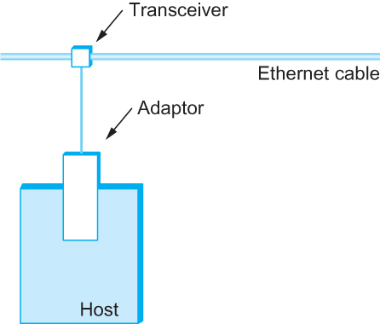
Ethernet
Ethernet transceiver and adaptor
Notes:
The University of Adelaide, School of Computer Science
Chapter 2 — Instructions: Language of the Computer

Slide 82
Ethernet
Multiple Ethernet segments can be joined together by repeaters.
A repeater is a device that forwards digital signals.
No more than four repeaters may be positioned between any pair of hosts.
  An Ethernet has a total reach of only 2500 m.
Notes:
The University of Adelaide, School of Computer Science
Chapter 2 — Instructions: Language of the Computer

Slide 83
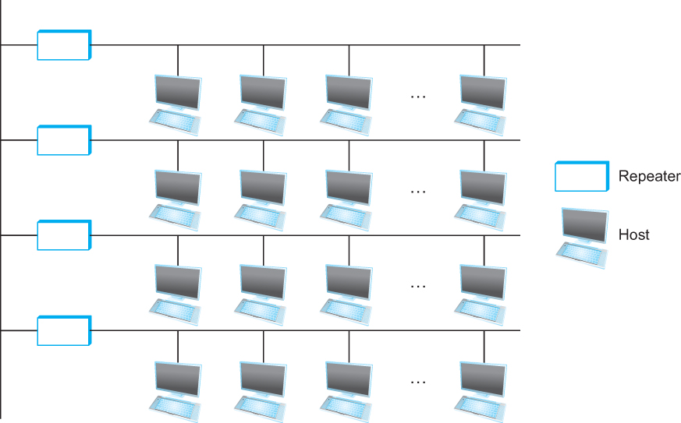
Ethernet
Ethernet repeater
Notes:
The University of Adelaide, School of Computer Science
Chapter 2 — Instructions: Language of the Computer

Slide 84
Ethernet
Any signal placed on the Ethernet by a host is broadcast over the entire network
  Signal is propagated in both directions.
  Repeaters forward the signal on all outgoing segments.
  Terminators attached to the end of each segment absorb the signal.
Ethernet uses Manchester encoding scheme.
Notes:
The University of Adelaide, School of Computer Science
Chapter 2 — Instructions: Language of the Computer

Slide 85
Ethernet
New Technologies in Ethernet
  Instead of using coax cable, an Ethernet can be constructed from a thinner cable known as 10Base2 (the original was 10Base5)
    10 means the network operates at 10 Mbps
    Base means the cable is used in a baseband system
    2 means that a given segment can be no longer than 200 m
Notes:
The University of Adelaide, School of Computer Science
Chapter 2 — Instructions: Language of the Computer

Slide 86
Ethernet
New Technologies in Ethernet
  Another cable technology is 10BaseT
    T stands for twisted pair
    Limited to 100 m in length
  With 10BaseT, the common configuration is to have several point to point segments coming out of a multiway repeater, called Hub
Notes:
The University of Adelaide, School of Computer Science
Chapter 2 — Instructions: Language of the Computer

Slide 87
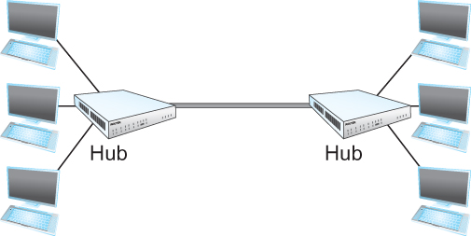
Ethernet
Ethernet Hub
Notes:
The University of Adelaide, School of Computer Science
Chapter 2 — Instructions: Language of the Computer

Slide 88
Access Protocol for Ethernet
The algorithm is commonly called Ethernet’s Media Access Control (MAC).
  It is implemented in Hardware on the network adaptor.
Frame format
  Preamble (64bit): allows the receiver to synchronize with the signal (sequence of alternating 0s and 1s).
  Host and Destination Address (48bit each).
  Packet type (16bit): acts as demux key to identify the higher level protocol.
  Data (up to 1500 bytes)
    Minimally a frame must contain at least 46 bytes of data.
    Frame must be long enough to detect collision.
  CRC (32bit)
Notes:
The University of Adelaide, School of Computer Science
Chapter 2 — Instructions: Language of the Computer

Slide 89

Ethernet Frame
Ethernet Frame Format
Notes:
The University of Adelaide, School of Computer Science
Chapter 2 — Instructions: Language of the Computer

Slide 90
Ethernet Addresses
Each host on an Ethernet (in fact, every Ethernet host in the world) has a unique Ethernet Address.
The address belongs to the adaptor, not the host.
  It is usually burnt into ROM.
Ethernet addresses are typically printed in a human readable format
  As a sequence of six numbers separated by colons.
  Each number corresponds to 1 byte of the 6 byte address and is given by a pair of hexadecimal digits, one for each of the 4-bit nibbles in the byte
  Leading 0s are dropped.
  For example, 8:0:2b:e4:b1:2 is
    00001000 00000000 00101011 11100100 10110001 00000010
Copyright © 2010, Elsevier Inc. All rights Reserved
Notes:
The University of Adelaide, School of Computer Science
Chapter 2 — Instructions: Language of the Computer

Slide 91
Ethernet Addresses
To ensure that every adaptor gets a unique address, each manufacturer of Ethernet devices is allocated a different prefix that must be prepended to the address on every adaptor they build
    AMD has been assigned the 24bit prefix 8:0:20
Notes:
The University of Adelaide, School of Computer Science
Chapter 2 — Instructions: Language of the Computer

Slide 92
Ethernet Addresses
Each frame transmitted on an Ethernet is received by every adaptor connected to that Ethernet.
Each adaptor recognizes those frames addressed to its address and passes only those frames on to the host.
In addition, to unicast address, an Ethernet address consisting of all 1s is treated as a broadcast address.
  All adaptors pass frames addressed to the broadcast address up to the host.
Similarly, an address that has the first bit set to 1 but is not the broadcast address is called a multicast address.
  A given host can program its adaptor to accept some set of multicast addresses.
Notes:
The University of Adelaide, School of Computer Science
Chapter 2 — Instructions: Language of the Computer

Slide 93
Ethernet Addresses
To summarize, an Ethernet adaptor receives all frames and accepts
  Frames addressed to its own address
  Frames addressed to the broadcast address
  Frames addressed to a multicast addressed if it has been instructed
Notes:
The University of Adelaide, School of Computer Science
Chapter 2 — Instructions: Language of the Computer

Slide 94
Ethernet Transmitter Algorithm
When the adaptor has a frame to send and the line is idle, it transmits the frame immediately.
  The upper bound of 1500 bytes in the message means that the adaptor can occupy the line for a fixed length of time.
When the adaptor has a frame to send and the line is busy, it waits for the line to go idle and then transmits immediately.
The Ethernet is said to be 1-persistent protocol because an adaptor with a frame to send transmits with probability 1 whenever a busy line goes idle.
Notes:
The University of Adelaide, School of Computer Science
Chapter 2 — Instructions: Language of the Computer

Slide 95
Ethernet Transmitter Algorithm
Since there is no centralized control it is possible for two (or more) adaptors to begin transmitting at the same time,
  Either because both found the line to be idle,
  Or, both had been waiting for a busy line to become idle.
When this happens, the two (or more) frames are said to be collide on the network.
Notes:
The University of Adelaide, School of Computer Science
Chapter 2 — Instructions: Language of the Computer

Slide 96
Ethernet Transmitter Algorithm
Since Ethernet supports collision detection, each sender is able to determine that a collision is in progress.
At the moment an adaptor detects that its frame is colliding with another, it first makes sure to transmit a 32-bit jamming sequence and then stops transmission.
  Thus, a transmitter will minimally send 96 bits in the case of collision
    64-bit preamble + 32-bit jamming sequence
Notes:
The University of Adelaide, School of Computer Science
Chapter 2 — Instructions: Language of the Computer

Slide 97
Ethernet Transmitter Algorithm
One way that an adaptor will send only 96 bit (called a runt frame) is if the two hosts are close to each other.
Had they been farther apart,
  They would have had to transmit longer, and thus send more bits, before detecting the collision.
Notes:
The University of Adelaide, School of Computer Science
Chapter 2 — Instructions: Language of the Computer

Slide 98
Ethernet Transmitter Algorithm
The worst case scenario happens when the two hosts are at opposite ends of the Ethernet.
To know for sure that the frame its just sent did not collide with another frame, the transmitter may need to send as many as 512 bits.
  Every Ethernet frame must be at least 512 bits (64 bytes) long.
    14 bytes of header + 46 bytes of data + 4 bytes of CRC
Notes:
The University of Adelaide, School of Computer Science
Chapter 2 — Instructions: Language of the Computer

Slide 99
Ethernet Transmitter Algorithm
Why 512 bits?
  Why is its length limited to 2500 m?
The farther apart two nodes are, the longer it takes for a frame sent by one to reach the other, and the network is vulnerable to collision during this time
Notes:
The University of Adelaide, School of Computer Science
Chapter 2 — Instructions: Language of the Computer

Slide 100
Ethernet Transmitter Algorithm
A begins transmitting a frame at time t
d denotes the one link latency
The first bit of A’s frame arrives at B at time t + d
Suppose an instant before host A’s frame arrives, host B begins to transmit its own frame
B’s frame will immediately collide with A’s frame and this collision will be detected by host B
Host B will send the 32-bit jamming sequence
Host A will not know that the collision occurred until B’s frame reaches it, which will happen at t + 2 * d
Host A must continue to transmit until this time in order to detect the collision
  Host A must transmit for 2 * d to be sure that it detects all possible collisions
Notes:
The University of Adelaide, School of Computer Science
Chapter 2 — Instructions: Language of the Computer

Slide 101
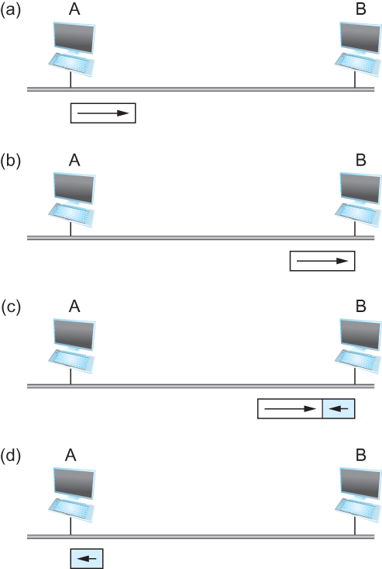
Ethernet Transmitter Algorithm
Worst-case scenario: (a) A sends a frame at time t; (b) A’s frame arrives
at B at time t + d; (c) B begins transmitting at time t + d and collides with A’s frame;
(d) B’s runt (32-bit) frame arrives at A at time t + 2d.
Notes:
The University of Adelaide, School of Computer Science
Chapter 2 — Instructions: Language of the Computer

Slide 102
Ethernet Transmitter Algorithm
Consider that a maximally configured Ethernet is 2500 m long, and there may be up to four repeaters between any two hosts, the round trip delay has been determined to be 51.2 μs
  Which on 10 Mbps Ethernet corresponds to 512 bits
The other way to look at this situation,
  We need to limit the Ethernet’s maximum latency to a fairly small value (51.2 μs) for the access algorithm to work
    Hence the maximum length for the Ethernet is on the order of 2500 m.
Copyright © 2010, Elsevier Inc. All rights Reserved
Notes:
The University of Adelaide, School of Computer Science
Chapter 2 — Instructions: Language of the Computer

Slide 103
Ethernet Transmitter Algorithm
Once an adaptor has detected a collision, and stopped its transmission, it waits a certain amount of time and tries again.
Each time the adaptor tries to transmit but fails, it doubles the amount of time it waits before trying again.
This strategy of doubling the delay interval between each retransmission attempt is known as Exponential Backoff.
Notes:
The University of Adelaide, School of Computer Science
Chapter 2 — Instructions: Language of the Computer

Slide 104
Ethernet Transmitter Algorithm
The adaptor first delays either 0 or 51.2 μs, selected at random.
If this effort fails, it then waits 0, 51.2, 102.4, 153.6 μs (selected randomly) before trying again;
  This is k * 51.2 for k = 0, 1, 2, 3
After the third collision, it waits k * 51.2 for k = 0…2³ – 1 (again selected at random).
In general, the algorithm randomly selects a k between 0 and 2^{n} – 1 and waits for k * 51.2 μs, where n is the number of collisions experienced so far.
Notes:
The University of Adelaide, School of Computer Science
Chapter 2 — Instructions: Language of the Computer

Slide 105
Experience with Ethernet
Ethernets work best under lightly loaded conditions.
  Under heavy loads, too much of the network’s capacity is wasted by collisions.
Most Ethernets are used in a conservative way.
  Have fewer than 200 hosts connected to them which is far fewer than the maximum of 1024.
Most Ethernets are far shorter than 2500m with a round-trip delay of closer to 5 μs than 51.2 μs.
Ethernets are easy to administer and maintain.
  There are no switches that can fail and no routing and configuration tables that have to be kept up-to-date.
  It is easy to add a new host to the network.
  It is inexpensive.
    Cable is cheap, and only other cost is the network adaptor on each host.
Copyright © 2010, Elsevier Inc. All rights Reserved
Notes:
The University of Adelaide, School of Computer Science
Chapter 2 — Instructions: Language of the Computer

Slide 106
Wireless Links
Wireless links transmit electromagnetic signals
  Radio, microwave, infrared
Wireless links all share the same “wire” (so to speak)
  The challenge is to share it efficiently without unduly interfering with each other
  Most of this sharing is accomplished by dividing the “wire” along the dimensions of frequency and space
Exclusive use of a particular frequency in a particular geographic area may be allocated to an individual entity such as a corporation
Notes:
The University of Adelaide, School of Computer Science
Chapter 2 — Instructions: Language of the Computer

Slide 107
Wireless Links
These allocations are determined by government agencies such as FCC (Federal Communications Commission) in USA
Specific bands (frequency) ranges are allocated to certain uses.
  Some bands are reserved for government use
  Other bands are reserved for uses such as AM radio, FM radio, televisions, satellite communications, and cell phones
  Specific frequencies within these bands are then allocated to individual organizations for use within certain geographical areas.
  Finally, there are several frequency bands set aside for “license exempt” usage
    Bands in which a license is not needed
Notes:
The University of Adelaide, School of Computer Science
Chapter 2 — Instructions: Language of the Computer

Slide 108
Wireless Links
Devices that use license-exempt frequencies are still subject to certain restrictions
  The first is a limit on transmission power
  This limits the range of signal, making it less likely to interfere with another signal
    For example, a cordless phone might have a range of about 100 feet.
Notes:
The University of Adelaide, School of Computer Science
Chapter 2 — Instructions: Language of the Computer

Slide 109
Wireless Links
The second restriction requires the use of Spread Spectrum technique
  Idea is to spread the signal over a wider frequency band
    So as to minimize the impact of interference from other devices
    Originally designed for military use
  Frequency hopping
    Transmitting signal over a random sequence of frequencies
      First transmitting at one frequency, then a second, then a third…
      The sequence of frequencies is not truly random, instead computed algorithmically by a pseudorandom number generator
      The receiver uses the same algorithm as the sender, initializes it with the same seed, and is
        Able to hop frequencies in sync with the transmitter to correctly receive the frame
Notes:
The University of Adelaide, School of Computer Science
Chapter 2 — Instructions: Language of the Computer

Slide 110
Wireless Links
A second spread spectrum technique called Direct sequence
  Represents each bit in the frame by multiple bits in the transmitted signal.
  For each bit the sender wants to transmit
    It actually sends the exclusive OR of that bit and n random bits
  The sequence of random bits is generated by a pseudorandom number generator known to both the sender and the receiver.
  The transmitted values, known as an n-bit chipping code, spread the signal across a frequency band that is n times wider
Notes:
The University of Adelaide, School of Computer Science
Chapter 2 — Instructions: Language of the Computer

Slide 111
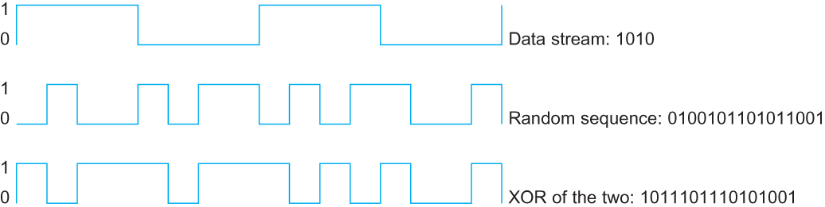
Wireless Links
Example 4-bit chipping sequence

Slide 112
Wireless Links
Wireless technologies differ in a variety of dimensions
  How much bandwidth they provide
  How far apart the communication nodes can be
Four prominent wireless technologies
  Bluetooth
  Wi-Fi (more formally known as 802.11)
  WiMAX (802.16)
  3G cellular wireless
Notes:
The University of Adelaide, School of Computer Science
Chapter 2 — Instructions: Language of the Computer

Slide 113
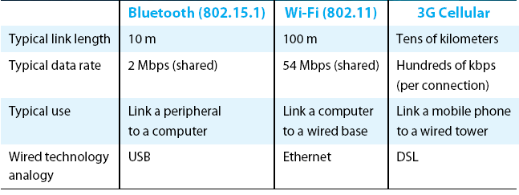
Wireless Links
Overview of leading wireless technologies
Copyright © 2010, Elsevier Inc. All rights Reserved

Slide 114
Wireless Links
Mostly widely used wireless links today are usually asymmetric
  Two end-points are usually different kinds of nodes
    One end-point usually has no mobility, but has wired connection to the Internet (known as base station)
    The node at the other end of the link is often mobile
Notes:
The University of Adelaide, School of Computer Science
Chapter 2 — Instructions: Language of the Computer

Slide 115
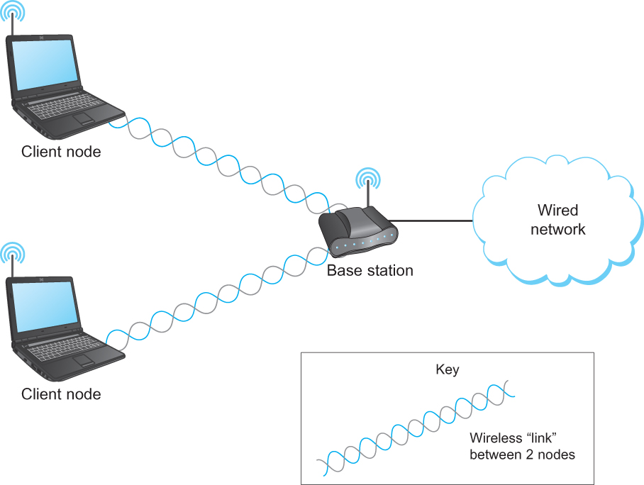
Wireless Links
A wireless network using a base station

Slide 116
Wireless Links
Wireless communication supports point-to-multipoint communication
Communication between non-base (client) nodes is routed via the base station
Three levels of mobility for clients
  No mobility: the receiver must be in a fix location to receive a directional transmission from the base station (initial version of WiMAX)
  Mobility is within the range of a base (Bluetooth)
  Mobility between bases (Cell phones and Wi-Fi)
Notes:
The University of Adelaide, School of Computer Science
Chapter 2 — Instructions: Language of the Computer

Slide 117
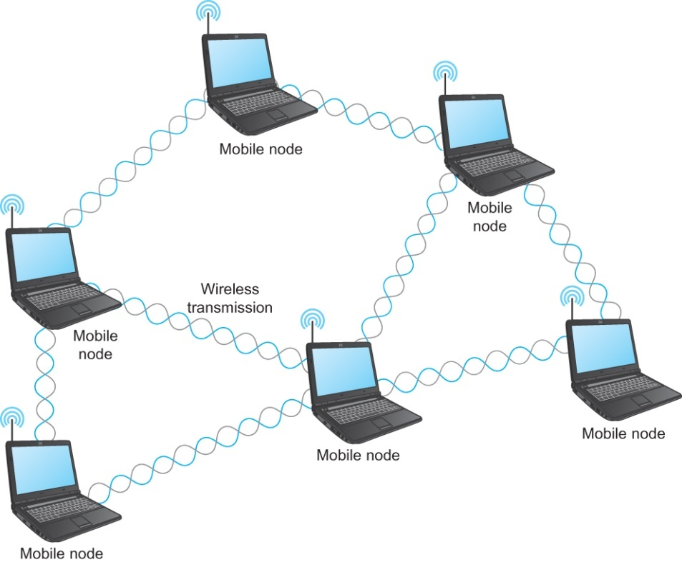
Wireless Links
Mesh or Ad-hoc network
  Nodes are peers
  Messages may be forwarded via a chain of peer nodes
A wireless ad-hoc or mesh network
Notes:
The University of Adelaide, School of Computer Science
Chapter 2 — Instructions: Language of the Computer

Slide 118
IEEE 802.11
Also known as Wi-Fi
Like its Ethernet and token ring siblings, 802.11 is designed for use in a limited geographical area (homes, office buildings, campuses)
  Primary challenge is to mediate access to a shared communication medium – in this case, signals propagating through space
802.11 supports additional features
  power management and
  security mechanisms
Notes:
The University of Adelaide, School of Computer Science
Chapter 2 — Instructions: Language of the Computer

Slide 119
IEEE 802.11
Original 802.11 standard defined two radio-based physical layer standard
  One using the frequency hopping
    Over 79 1-MHz-wide frequency bandwidths
  Second using direct sequence
    Using 11-bit chipping sequence
  Both standards run in the 2.4-GHz and provide up to 2 Mbps
Then physical layer standard 802.11b was added
  Using a variant of direct sequence 802.11b provides up to 11 Mbps
  Uses license-exempt 2.4-GHz band
Then came 802.11a which delivers up to 54 Mbps using OFDM
  802.11a runs on license-exempt 5-GHz band
Most recent standard is 802.11g which is backward compatible with 802.11b
  Uses 2.4 GHz band, OFDM and delivers up to 54 Mbps
Copyright © 2010, Elsevier Inc. All rights Reserved
Notes:
The University of Adelaide, School of Computer Science
Chapter 2 — Instructions: Language of the Computer

Slide 120
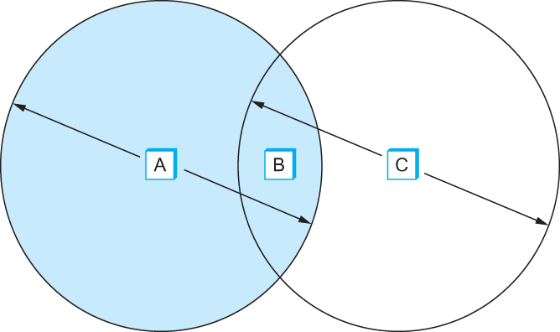
IEEE 802.11 – Collision Avoidance
Consider the situation in the following figure where each of four nodes is able to send and receive signals that reach just the nodes to its immediate left and right
  For example, B can exchange frames with A and C, but it cannot reach D
  C can reach B and D but not A
Example of a wireless network
Notes:
The University of Adelaide, School of Computer Science
Chapter 2 — Instructions: Language of the Computer

Slide 121
IEEE 802.11 – Collision Avoidance
Suppose both A and C want to communicate with B and so they each send it a frame.
  A and C are unaware of each other since their signals do not carry that far
  These two frames collide with each other at B
    But unlike an Ethernet, neither A nor C is aware of this collision
  A and C are said to hidden nodes with respect to each other
Notes:
The University of Adelaide, School of Computer Science
Chapter 2 — Instructions: Language of the Computer

Slide 122
IEEE 802.11 – Collision Avoidance
The “Hidden Node” Problem. Although A and C are hidden from each
other, their signals can collide at B. (B’s reach is not shown.)

Slide 123
IEEE 802.11 – Collision Avoidance
Another problem called exposed node problem occurs
  Suppose B is sending to A. Node C is aware of this communication because it hears B’s transmission.
  It would be a mistake for C to conclude that it cannot transmit to anyone just because it can hear B’s transmission.
  Suppose C wants to transmit to node D.
  This is not a problem since C’s transmission to D will not interfere with A’s ability to receive from B.
Notes:
The University of Adelaide, School of Computer Science
Chapter 2 — Instructions: Language of the Computer

Slide 124
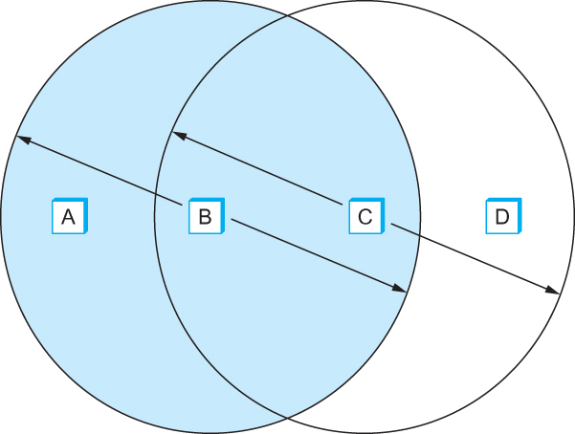
IEEE 802.11 – Collision Avoidance
Exposed Node Problem. Although B and C are exposed to each other’s
signals, there is no interference if B transmits to A while C transmits to D. (A and D’s
reaches are not shown.)

Slide 125
IEEE 802.11 – Collision Avoidance
802.11 addresses these two problems with an algorithm called Multiple Access with Collision Avoidance (MACA).
Key Idea
  Sender and receiver exchange control frames with each other before the sender actually transmits any data.
  This exchange informs all nearby nodes that a transmission is about to begin
  Sender transmits a Request to Send (RTS) frame to the receiver.
    The RTS frame includes a field that indicates how long the sender wants to hold the medium
      - Length of the data frame to be transmitted
  Receiver replies with a Clear to Send (CTS) frame
    This frame echoes this length field back to the sender
Notes:
The University of Adelaide, School of Computer Science
Chapter 2 — Instructions: Language of the Computer

Slide 126
IEEE 802.11 – Collision Avoidance
Any node that sees the CTS frame knows that
  it is close to the receiver, therefore
  cannot transmit for the period of time it takes to send a frame of the specified length
Any node that sees the RTS frame but not the CTS frame
  is not close enough to the receiver to interfere with it, and
  so is free to transmit
Notes:
The University of Adelaide, School of Computer Science
Chapter 2 — Instructions: Language of the Computer

Slide 127
IEEE 802.11 – Collision Avoidance
Using ACK in MACA
  Proposed in MACAW: MACA for Wireless LANs
Receiver sends an ACK to the sender after successfully receiving a frame
All nodes must wait for this ACK before trying to transmit
If two or more nodes detect an idle link and try to transmit an RTS frame at the same time
  Their RTS frame will collide with each other
802.11 does not support collision detection
  So the senders realize the collision has happened when they do not receive the CTS frame after a period of time
  In this case, they each wait a random amount of time before trying again.
  The amount of time a given node delays is defined by the same exponential backoff algorithm used on the Ethernet.
Copyright © 2010, Elsevier Inc. All rights Reserved
Notes:
The University of Adelaide, School of Computer Science
Chapter 2 — Instructions: Language of the Computer

Slide 128
IEEE 802.11 – Distribution System
802.11 is suitable for an ad-hoc configuration of nodes that may or may not be able to communicate with all other nodes.
Nodes are free to move around
The set of directly reachable nodes may change over time
To deal with this mobility and partial connectivity,
  802.11 defines additional structures on a set of nodes
  Instead of all nodes being created equal,
    some nodes are allowed to roam
    some are connected to a wired network infrastructure
      - they are called Access Points (AP) and they are connected to each other by a so-called distribution system
Copyright © 2010, Elsevier Inc. All rights Reserved
Notes:
The University of Adelaide, School of Computer Science
Chapter 2 — Instructions: Language of the Computer

Slide 129
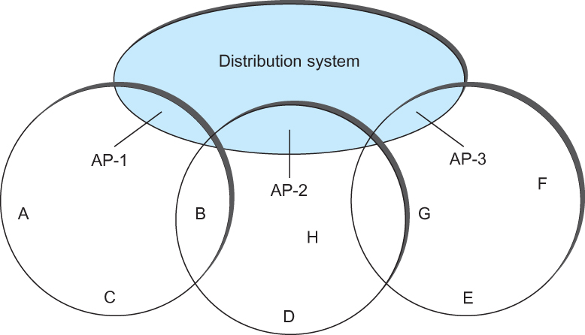
IEEE 802.11 – Distribution System
Following figure illustrates a distribution system that connects three access points, each of which services the nodes in the same region
Each of these regions is analogous to a cell in a cellular phone system with the APIs playing the same role as a base station
The distribution network runs at layer 2 of the ISO architecture
Access points connected to a distribution network
Notes:
The University of Adelaide, School of Computer Science
Chapter 2 — Instructions: Language of the Computer

Slide 130
IEEE 802.11 – Distribution System
Although two nodes can communicate directly with each other if they are within reach of each other, the idea behind this configuration is
  Each nodes associates itself with one access point
  For node A to communicate with node E, A first sends a frame to its AP-1 which forwards the frame across the distribution system to AP-3, which finally transmits the frame to E
Access points connected to a distribution network
Notes:
The University of Adelaide, School of Computer Science
Chapter 2 — Instructions: Language of the Computer

Slide 131
IEEE 802.11 – Distribution System
How do the nodes select their access points
How does it work when nodes move from one cell to another
The technique for selecting an AP is called scanning
  The node sends a Probe frame
  All APs within reach reply with a Probe Response frame
  The node selects one of the access points and sends that AP an Association Request frame
  The AP replies with an Association Response frame
A node engages this protocol whenever
  it joins the network, as well as
  when it becomes unhappy with its current AP
    This might happen, for example, because the signal from its current AP has weakened due to the node moving away from it
    Whenever a node acquires a new AP, the new AP notifies the old AP of the change via the distribution system
Copyright © 2010, Elsevier Inc. All rights Reserved
Notes:
The University of Adelaide, School of Computer Science
Chapter 2 — Instructions: Language of the Computer

Slide 132
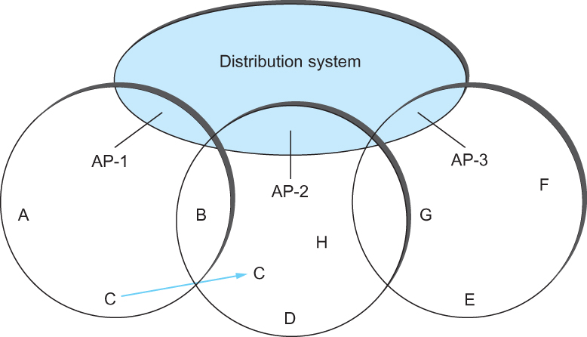
IEEE 802.11 – Distribution System
Consider the situation shown in the following figure when node C moves from the cell serviced by AP-1 to the cell serviced by AP-2.
As it moves, it sends Probe frames, which eventually result in Probe Responses from AP-2.
At some point, C prefers AP-2 over AP-1 , and so it associates itself with that access point.
  This is called active scanning since the node is actively searching for an access point
Node Mobility
Notes:
The University of Adelaide, School of Computer Science
Chapter 2 — Instructions: Language of the Computer

Slide 133
IEEE 802.11 – Distribution System
APs also periodically send a Beacon frame that advertises the capabilities of the access point; these include the transmission rate supported by the AP
  This is called passive scanning
  A node can change to this AP based on the Beacon frame simply by sending it an Association Request frame back to the access point.
Node Mobility
Notes:
The University of Adelaide, School of Computer Science
Chapter 2 — Instructions: Language of the Computer

Slide 134
IEEE 802.11 – Frame Format
Source and Destinations addresses: each 48 bits
Data: up to 2312 bytes
CRC: 32 bit
Control field: 16 bits
  Contains three subfields (of interest)
    6 bit Type field: indicates whether the frame is an RTS or CTS frame or being used by the scanning algorithm
    A pair of 1 bit fields : called ToDS and FromDS
Frame Format
Notes:
The University of Adelaide, School of Computer Science
Chapter 2 — Instructions: Language of the Computer

Slide 135
IEEE 802.11 – Frame Format
Frame contains four addresses
How these addresses are interpreted depends on the settings of the ToDS and FromDS bits in the frame’s Control field
This is to account for the possibility that the frame had to be forwarded across the distribution system which would mean that,
  the original sender is not necessarily the same as the most recent transmitting node
Same is true for the destination address
Simplest case
  When one node is sending directly to another, both the DS bits are 0, Addr1 identifies the target node, and Addr2 identifies the source node
Notes:
The University of Adelaide, School of Computer Science
Chapter 2 — Instructions: Language of the Computer

Slide 136
IEEE 802.11 – Frame Format
Most complex case
  Both DS bits are set to 1
    Indicates that the message went from a wireless node onto the distribution system, and then from the distribution system to another wireless node
  With both bits set,
    Addr1 identifies the ultimate destination,
    Addr2 identifies the immediate sender (the one that forwarded the frame from the distribution system to the ultimate destination)
    Addr3 identifies the intermediate destination (the one that accepted the frame from a wireless node and forwarded across the distribution system)
    Addr4 identifies the original source
Addr1: E, Addr2: AP-3, Addr3: AP-1, Addr4: A
Notes:
The University of Adelaide, School of Computer Science
Chapter 2 — Instructions: Language of the Computer

Slide 137
Bluetooth
Used for very short range communication between mobile phones, PDAs, notebook computers and other personal or peripheral devices
Operates in the license-exempt band at 2.45 GHz
Has a range of only 10 m
Communication devices typically belong to one individual or group
  Sometimes categorized as Personal Area Network (PAN)
Version 2.0 provides speeds up to 2.1 Mbps
Power consumption is low
Notes:
The University of Adelaide, School of Computer Science
Chapter 2 — Instructions: Language of the Computer

Slide 138
Bluetooth
Bluetooth is specified by an industry consortium called the Bluetooth Special Interest Group
It specifies an entire suite of protocols, going beyond the link layer to define application protocols, which it calls profiles, for a range of applications
  There is a profile for synchronizing a PDA with personal computer
  Another profile gives a mobile computer access to a wired LAN
The basic Bluetooth network configuration is called a piconet
  Consists of a master device and up to seven slave devices
  Any communication is between the master and a slave
  The slaves do not communicate directly with each other
  A slave can be parked: set to an inactive, low-power state
Copyright © 2010, Elsevier Inc. All rights Reserved
Notes:
The University of Adelaide, School of Computer Science
Chapter 2 — Instructions: Language of the Computer

Slide 139
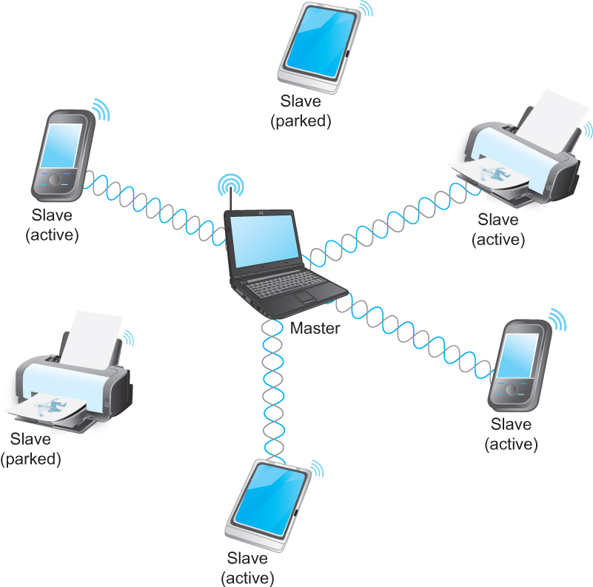
Bluetooth
A Bluetooth Piconet

Slide 140
ZigBee
ZigBee is a new technology that competes with Bluetooth
Devised by the ZigBee alliance and standardized as IEEE 802.15.4
It is designed for situations where the bandwidth requirements are low and power consumption must be very low to give very long battery life
It is also intended to be simpler and cheaper than Bluetooth, making it financially feasible to incorporate in cheaper devices such as a wall switch that wirelessly communicates with a ceiling-mounted fan
Notes:
The University of Adelaide, School of Computer Science
Chapter 2 — Instructions: Language of the Computer

Slide 141
Summary
We introduced the many and varied type of links that are used to connect users to existing networks, and to construct large networks from scratch.
We looked at the five key issues that must be addressed so that two or more nodes connected by some medium can exchange messages with each other
  Encoding
  Framing
  Error Detecting
  Reliability
  Multiple Access Links
    Ethernet
    Wireless 802.11, Bluetooth
Notes:
The University of Adelaide, School of Computer Science
Chapter 2 — Instructions: Language of the Computer

